Slide 1
The Kodak Tragedy
Storyboarding - W201 Week 9
Nishant Velagapudi
11/2/2017
Notes:
Speaker FirstName
Speaker Script or Notes

Slide 2

Once Upon a time
https://hbr.org/2016/07/kodaks-downfall-wasnt-about-technology
Notes:
Nishant Velagapudi
The film industry was dominated by a company called Kodak
Dry plate imaging started in 1880, sold in 1888

Slide 3
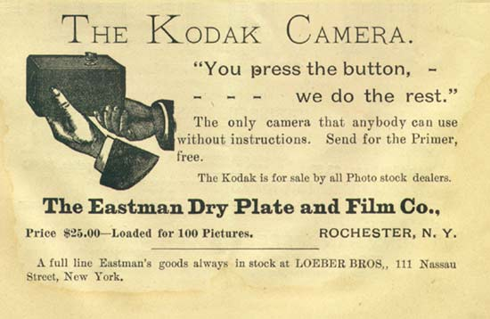
Every day...
https://upload.wikimedia.org/wikipedia/commons/8/8e/You_press_the_button%2C_we_do_the_rest_%28Kodak%29.jpg
Notes:
Speaker Name
90% of film in the US, 60,000 jobs in Rochester alone

Slide 4
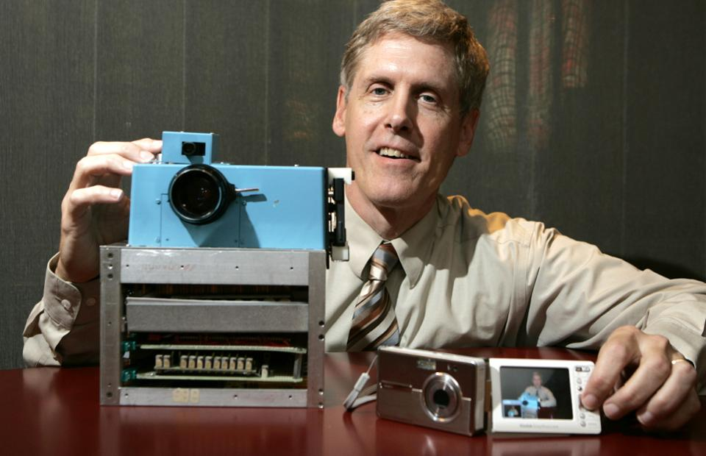
One day...
2. https://www.forbes.com/sites/tendayiviki/2017/01/19/on-the-fifth-anniversary-of-kodaks-bankruptcy-how-can-large-companies-sustain-innovation/#79e306686280
Notes:
Nishant Velagapudi
A scientist named Steven Sasson invents the digital camera. What few realize is that Sasson was actually a Kodak engineer at the time!
Kodak didn’t miss the digital revolution.

Slide 5
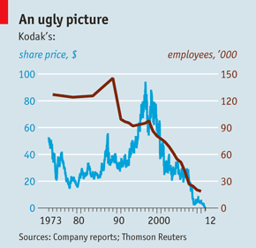
… and because of this:
3. http://www.economist.com/node/21542796
Notes:
Speaker Name
Speaker Notes

Slide 6
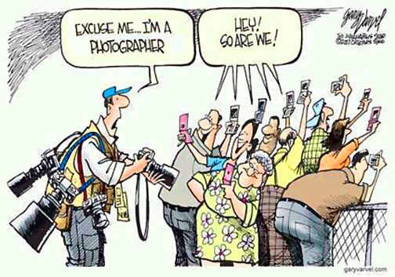
… and because of this:
3. http://atommagadia.blogspot.com/2012/01/photography-after-kodak.html
Notes:
Kodak actually anticipated the shift to digital photography and successfully created a line of digital cameras.
Purchased an online photo sharing company - but tried to use it to push photo printing

Slide 7
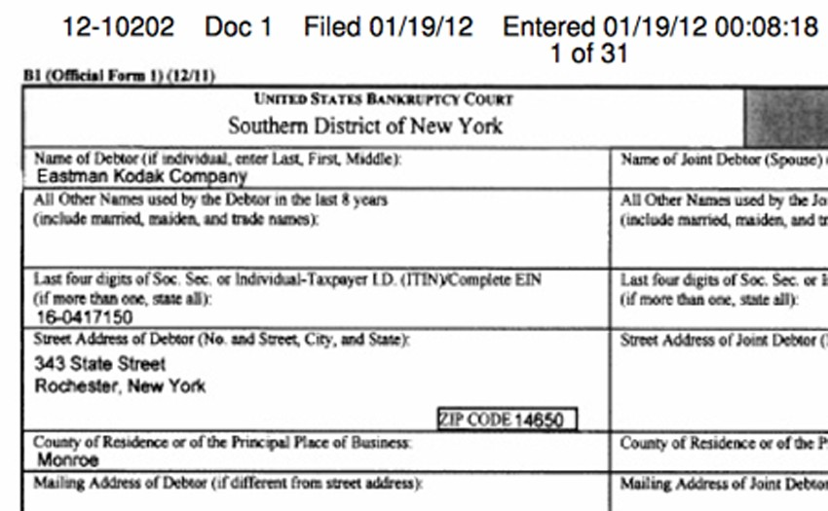
And finally...
3. http://photoseed.com/blog/2012/01/19/kodaks-work-not-done/
Notes:
Speaker Name
Three years of consecutive losses took it’s toll.
$40 a share in 2003 to $.78 a share late 2011

Slide 8
Since that day
Kodak Files For Bankruptcy
3 consecutive years of losses lead to a bankruptcy filing
Kodak reports a profitable quarter for the first time since bankruptcy
2013
2016
2012
2014
Kodak stock is traded once more
Kodak reports its first annual profit since bankruptcy
Notes:
Kodak has slowly recovered
Smaller company - cut expenses by over 50%
Focused on commercial imaging

Slide 9
References
https://hbr.org/2016/07/kodaks-downfall-wasnt-about-technology
https://upload.wikimedia.org/wikipedia/commons/8/8e/You_press_the_button%2C_we_do_the_rest_%28Kodak%29.jpg
https://www.forbes.com/sites/tendayiviki/2017/01/19/on-the-fifth-anniversary-of-kodaks-bankruptcy-how-can-large-companies-sustain-innovation/#79e306686280
http://www.economist.com/node/21542796
http://atommagadia.blogspot.com/2012/01/photography-after-kodak.html
http://photoseed.com/blog/2012/01/19/kodaks-work-not-done/

